Slide 1
EMPLOYEE VOICE AND ORGANIZATIONAL DUE PROCESS

Slide 2
Employee Voice
-refers to the participation of employees in influencing corporate decision making.

Slide 3
Informal and Formal Mechanisms
Informal Employee Voice Mechanisms
Formal Employee Voice Mechanisms

Slide 4
Due Process
Distributive Justice
Perceived fairness in the distribution of outcomes.
Procedural Justice
Perceived fairness of the process used to make decision about employees.

Slide 5
Right to Due Process
What is the doctrine of employment at will?
What are the criticisms of the doctrine of employment at will?
What is due process?
How can organizations implement due process?

Slide 6
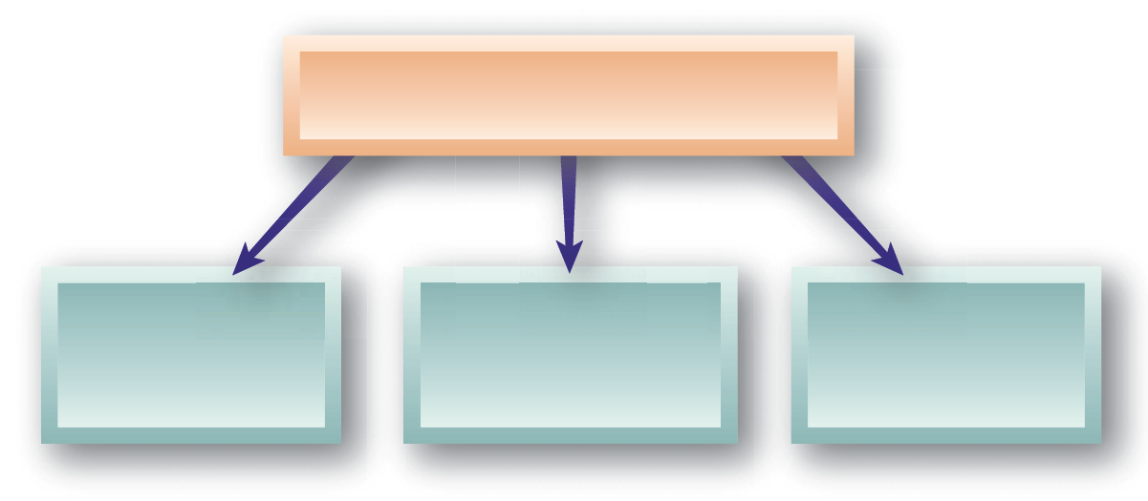
Employees’ Free Speech Rights
Employers’ Restrictions on Employees’ Free Speech Rights
Advocacy of Controversial Views
Engaging in Whistle-Blowing
Publication of Blogs

Slide 7
Employee Handbooks
At-Will Prerogatives
Pay/Overtime
Harassment
Policies in
Handbooks
Discipline
Electronic Communication
Benefits

Slide 8
Employee Discipline
Approaches to Discipline
Positive Discipline
Progressive Discipline
Counseling
Written Documentation
Final Warning (decision day-off)
Discharge
Verbal Caution
Written Reprimand
Suspension
Discharge

